Slide 1

Basic Solutions Concepts (pt 4)
Chris Kiekintveld

Slide 2
Dominance In Games
As in single-agent decisions, sometimes there is a clear “best” action for all situations
If one action a₁ has a higher payoff than another action a₂ for every possible profile of opponent actions, a₁ dominates a₂
If one strategy dominates all others, it is a dominant strategy for that player

Slide 3
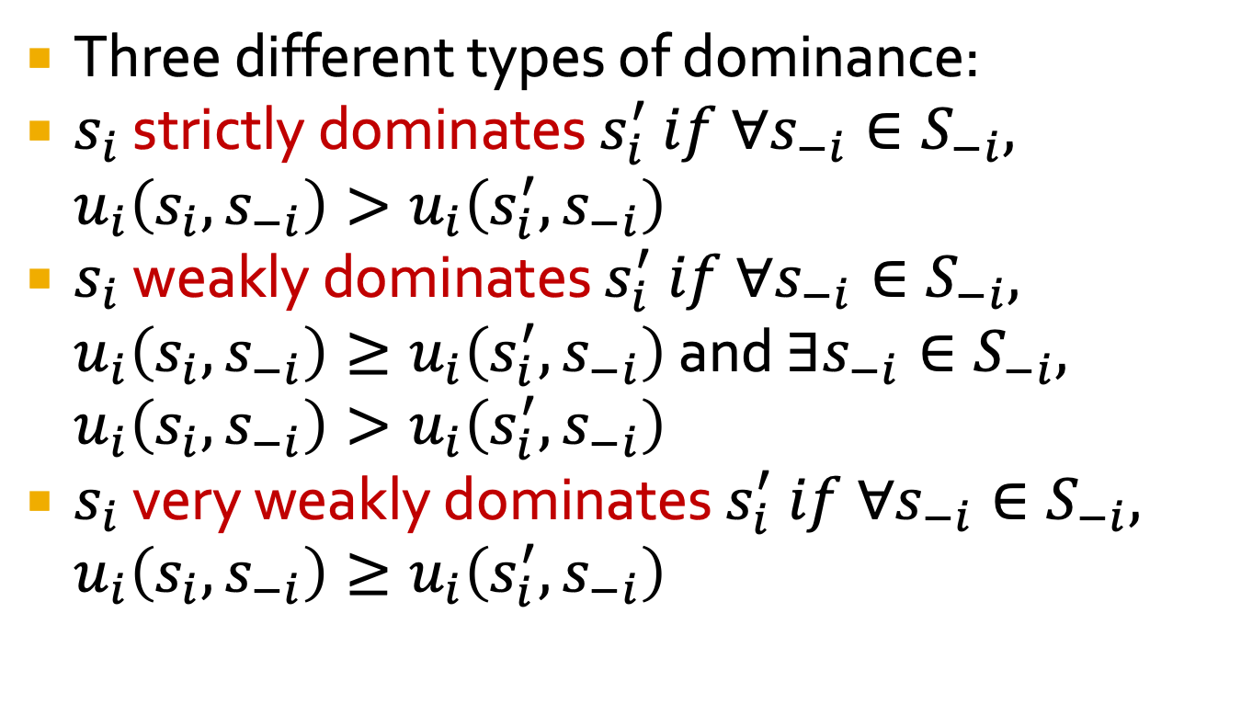
Types of Dominance
Three different types of dominance:
$s_{i}$ strictly dominates $s_{i}^{′} if ∀s_{−i}∈S_{−i}, u_{i}\left(s_{i},s_{−i}\right)>u_{i}\left(s_{i}^{′},s_{−i}\right)$
$s_{i}$ weakly dominates $s_{i}^{′} if ∀s_{−i}∈S_{−i}, u_{i}\left(s_{i},s_{−i}\right)≥u_{i}\left(s_{i}^{′},s_{−i}\right)$ and $∃s_{−i}∈S_{−i}, u_{i}\left(s_{i},s_{−i}\right)>u_{i}\left(s_{i}^{′},s_{−i}\right)$
$s_{i}$ very weakly dominates $s_{i}^{′} if ∀s_{−i}∈S_{−i}, u_{i}\left(s_{i},s_{−i}\right)≥u_{i}\left(s_{i}^{′},s_{−i}\right)$

Slide 4
Dominance and NE
Dominated strategies cannot be part of a NE
This can be used to prune the strategy space and make the game simpler (including in algorithms)
A strategy profile consisting of dominant strategies for all players must be a NE
If all strategies are strictly dominant, the NE is unique

Slide 5
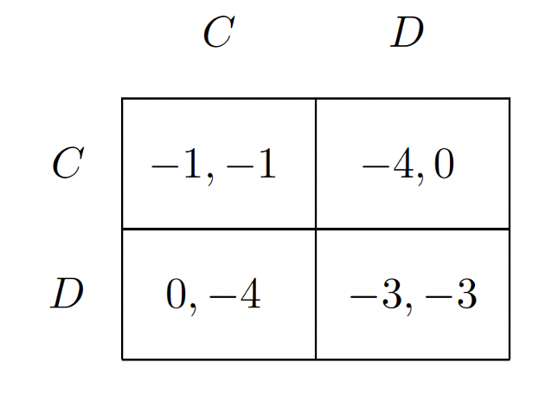
Prisoner’s Dilemma (again)
The profile (D,D) is the only one that is NOT pareto-optimal (it is dominated by (C,C))
(D,D) is the only NE
D is a strictly dominant action for both players

Slide 6
Traveler’s Dilemma
Two travelers purchase identical African masks while on a
tropical vacation. Their luggage is lost on the return trip,
and the airline asks them to make independent claims for
compensation. In anticipation of excessive claims, the
airline representative announces:
“We know that the bags have identical contents, and we will entertain any claim between $180 and $300, but you will each be reimbursed at an amount that equals the minimum of the two claims submitted. If the two claims differ, we will
also pay a reward R to the person making the smaller claim and we will deduct a penalty R from the reimbursement to the person making the larger claim."

Slide 7
Traveler’s Dilemma
Action: choose an integer between 180 and 300
If both players pick the same number, they both get that amount as payoff
If players pick a different number:
the low player gets his number (L) plus some constant R
the high player gets L - R, R = 5.
Think about how you would play this game

Slide 8
Traveler’s Dilemma
Action: choose an integer between 180 and 300
If both players pick the same number, they both get that amount as payoff
If players pick a different number:
the low player gets his number (L) plus some constant R
the high player gets L - R, R = 5.
Think about how you would play this game
Now set R = 180 and reconsider your strategy
What has changed?
How are you analyzing the game?

Slide 9
Analysis
This game can be solve by iteratively eliminating dominated strategies
e.g., 300 is dominated by 299
write out a partial payoff matrix to see why
For all R >= 2, (180, 180) is the only NE
What happens experimentally?
With R = 5 most people choose 295-300 at least initially
With R = 180 most people choose 180

Slide 10
Iterated Removal
No equilibrium can involve a strictly dominated strategy
Identify a dominated strategy
Remove it, leading to a smaller/simpler game
This may allow additional strategies to be removed
Running this process to termination (no more dominated strategies) is iterated removal of dominated strategies
Might results in a unique NE solution (as in PD)
Can be a pre-processing step before other algorithms

Slide 11
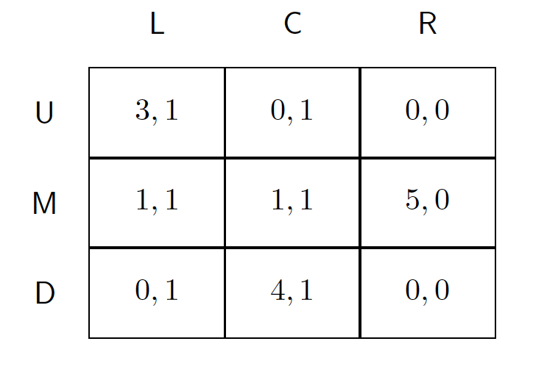
Example
R is dominated by L

Slide 12
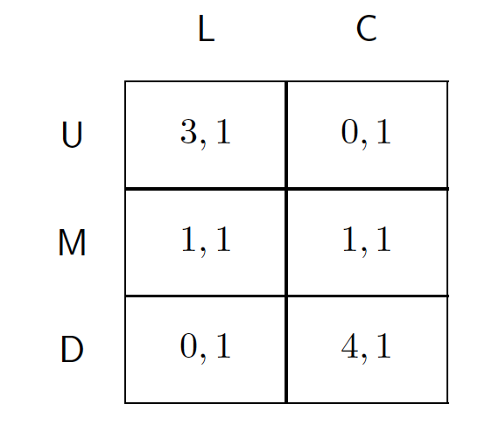
Example
M is dominated by a mixed
strategy of 50% U, 50% D

Slide 13
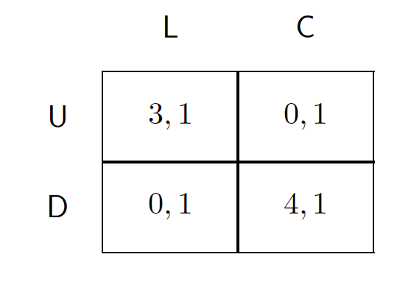
Example
Nothing else is dominated

Slide 14
Iterated Removal Properties
This process preserves Nash equilibria.
strict dominance: all equilibria preserved.
weak or very weak dominance: at least one equilibrium preserved
Thus, it can be used as a preprocessing step before computing an equilibrium
Some games are solvable using this technique.
Example: Traveler's Dilemma!
What about the order of removal when there are multiple dominated strategies?
strict dominance: doesn't matter.
weak or very weak dominance: can affect which equilibria are preserved

